Slide 1
Experiential Learning
Course Code:22CS35A1
CREATING EFFICIENT LINUX MEMORY
MANAGER(HEAP MEMORY MANAGER)
GURURAJ BASAVARAJ GHATIGENNAVAR – 1RV22CS060
KUSHAL R – 1RV22CS93
HRUTHIK K K– 1RV22CS071
KIRAN – 1RV22CS086

Slide 2
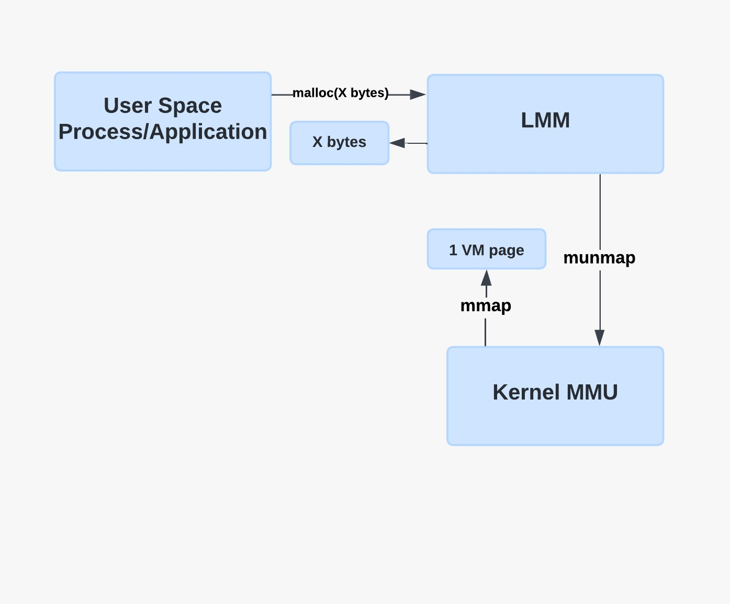
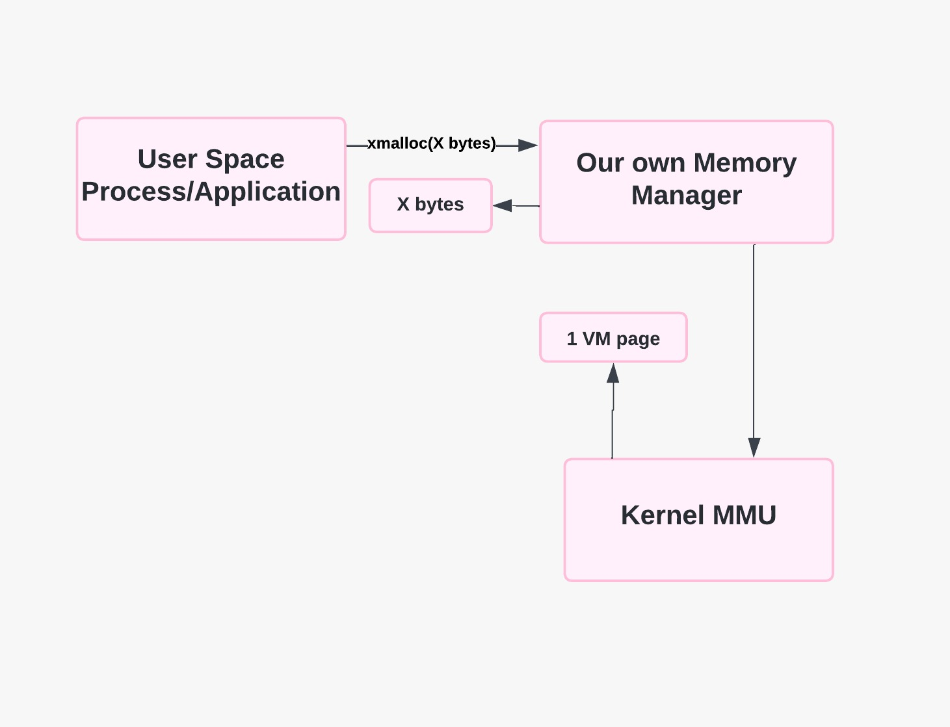
Problem Statement

Slide 3
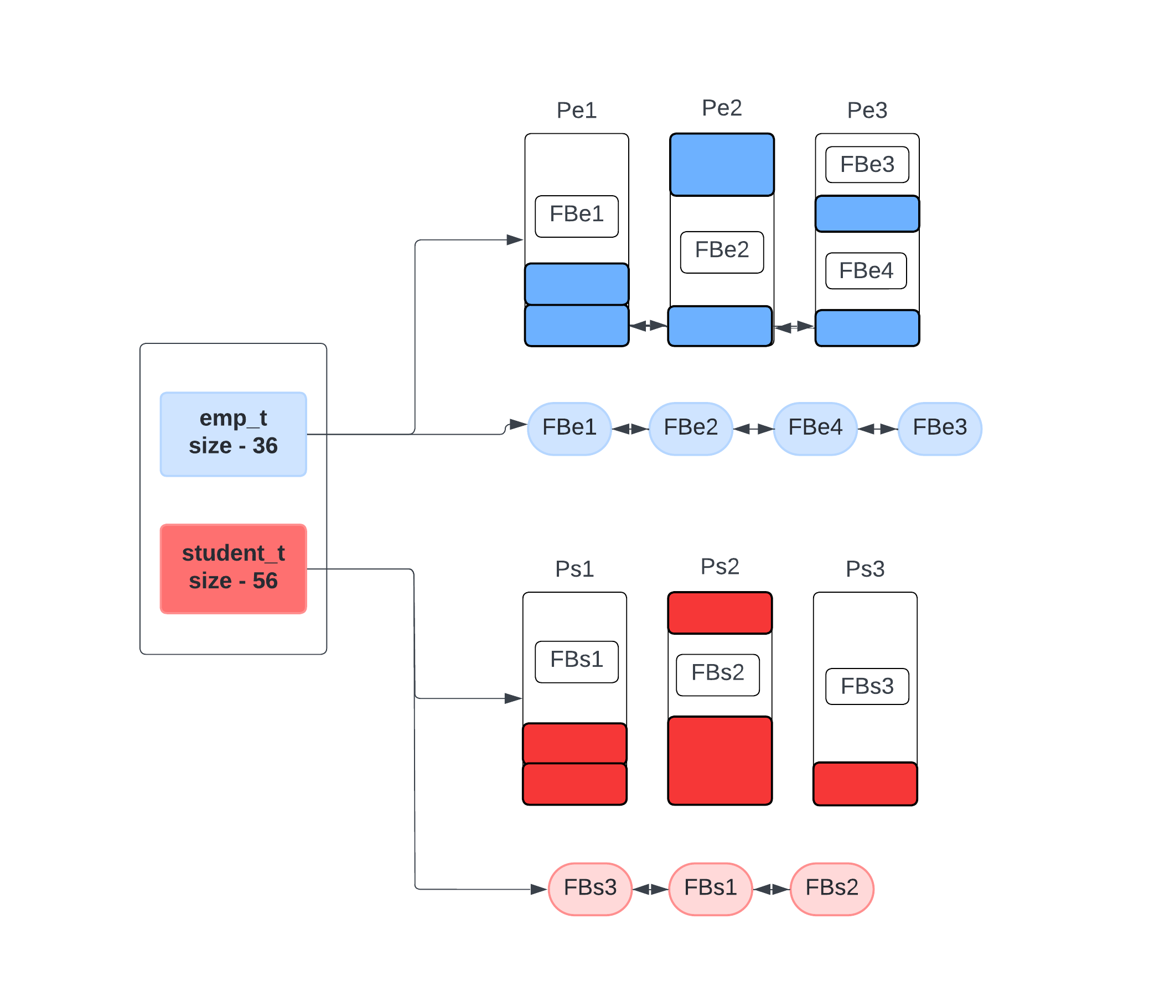
Structural Components in Memory Administration

Slide 4
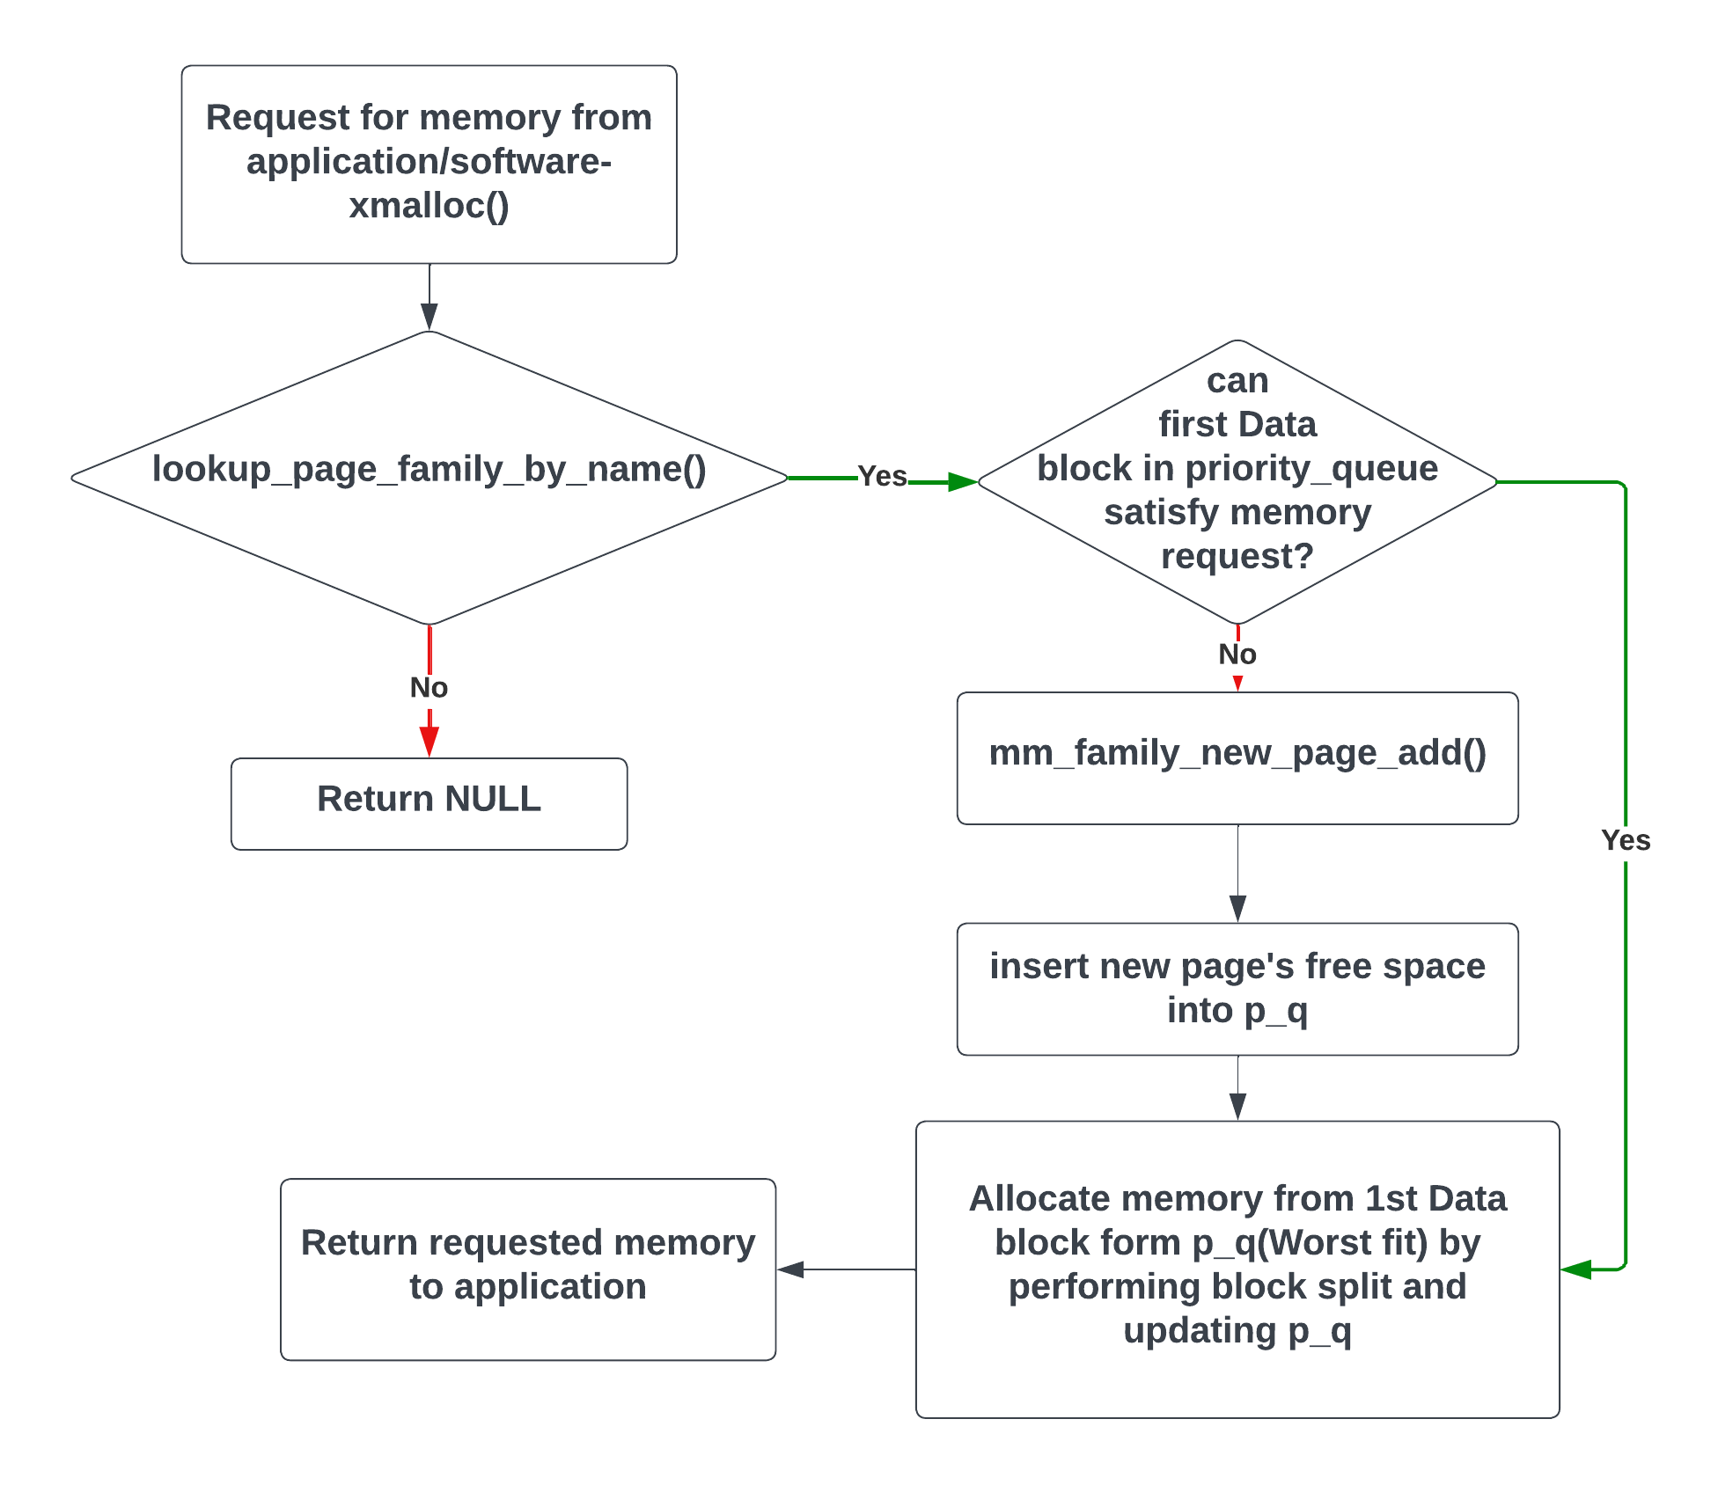
xmalloc()
implementaion

Slide 5
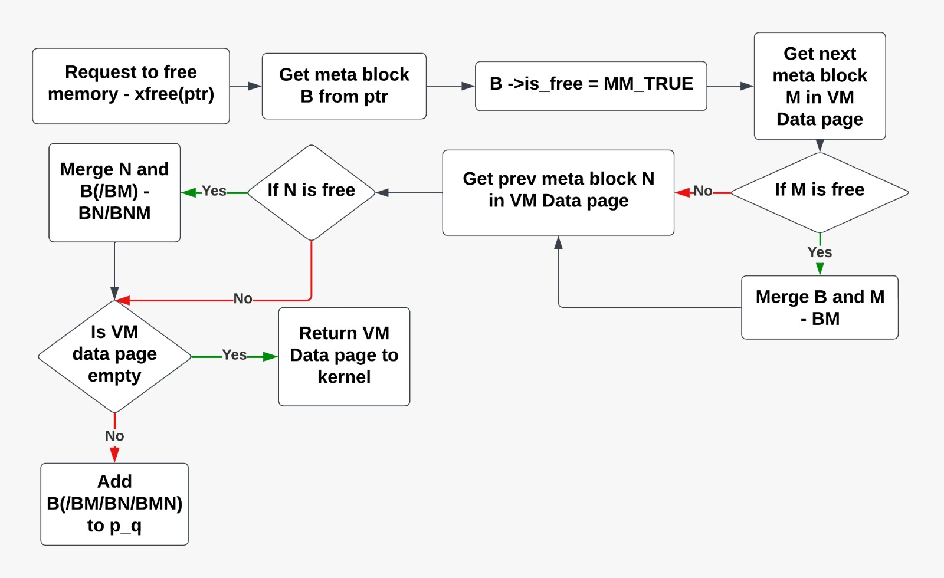
xfree() implementation

Slide 6
Features
Initialization: Upon startup, It set up the initial parameters like page size and obtain the starting address of the heap segment.
Page Allocation: It allocate memory pages either from the heap segment using sbrk() or directly from the kernel using mmap() based on the configured method.
Page Management: It keep track of allocated and free pages using linked lists and manage them efficiently for allocation and deallocation.
Heap Expansion: When required, It expand the heap segment to accommodate additional memory pages, ensuring continuous availability of memory.
Error Handling: It handle errors during page allocation, such as failing to expand the heap segment or encountering errors with mmap().

Slide 7
Page Size Calculation: It calculate the page size dynamically using getpagesize() to ensure compatibility across different systems.
Memory Management Instance: It maintain a memory management instance to handle multiple memory allocation requests concurrently.
Efficiency: It optimize memory allocation by reusing free pages whenever possible and minimizing fragmentation through intelligent page management.
Flexibility: It provide flexibility by allowing the use of different methods for page allocation, such as sbrk() or mmap(), depending on the system configuration.
Interfacing: It expose interfaces to allocate, deallocate, and manage memory pages, providing a seamless experience for higher-level applications.

